Slide 1
COURSE
Selling Ancillary Insurance Products
Senior Market Advisors University

Slide 2
Training Overview
In this module, you will learn:
Presentation techniques
Facts and figures
The CSG quoting tool
Other resources you can use

Slide 3
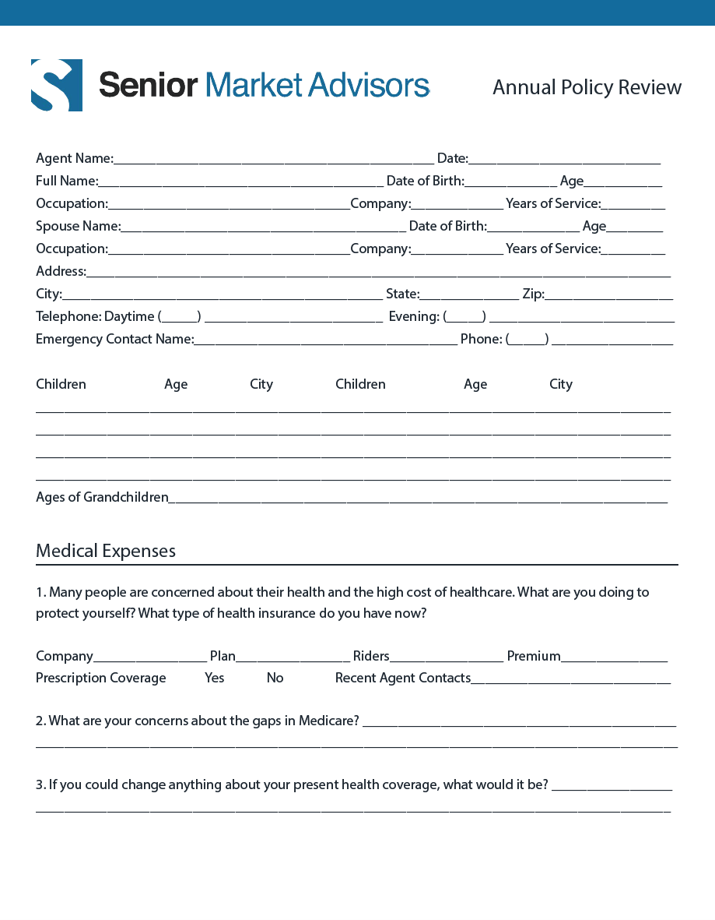
Needs Analysis.
Specific for an Annual Policy Review

Slide 4
Did you know?
Medical bills are the leading cause of personal bankruptcy filings.*
Having health insurance is not guaranteed protection from major, life-changing hospital expenses.
Even the best health insurance won’t cover all health costs.
Three of every five bankruptcies are due to unpaid medical bills.*
78% of people that file for medical bankruptcy had health insurance.**
*http://www.nerdwallet.com/blog/health/2014/03/26/medical-bankruptcy/
**http://www.foxbusiness.com/personal-finance/2014/02/18/medical-bankruptcies-are-still-problem-here-what-to-expect/

Slide 5
Policies Designed for You.
Paying the bills when Medicare stops
Affordable: can be tailored to fit most budgets, even with a fixed income
Provides cash directly to you when you need it the most (UB-04 Form or Pathology Report)
You can choose how to spend your money:
Offset the cost of Co-pays and Deductibles
Pay for Out-of-Pocket Expense
Help make up for lost wages

Slide 6
LESSON
Hospital Indemnity
Senior Market Advisors University

Slide 7
Hospital Indemnity
Introduction
Most health insurance plans have coverage “gaps”, out-of-pocket expenses and co-payments
Many times, policyholders don’t understand, are not aware of and are not prepared for how quickly these out-of-pocket expenses can add up
The “Gaps” can quickly add up. Does your client’s health insurance have deductibles or co-payments for:
Hospital Confinement?
Ambulance Trips?
Cancer Treatments?
Skilled Nursing?

Slide 8
What is Hospital Indemnity Insurance?
Even if you have excellent medical insurance with comprehensive benefits you are still responsible for paying
Deductibles
Co-pays
Co-insurance
Non-covered medical expenses
With hospital indemnity insurance, the company pays a benefit to you when you or a covered family member becomes sick or injured.

Slide 9
Review Client’s Medical Coverage
Ask for the Summary of Benefits
What insurance coverage is in place now?
How does it handle a hospital stay?
How does it handle a nursing facility stay?
How does it handle a cancer diagnosis?
How does it cover Part B drugs?
What will the financial implication be to your client if one or more of these events occur?

Slide 10
SOB Example: Emergency Room
Ambulance Service - $100
Emergency Care - $65
“Mr. Williams that means if you used both of these services you are responsible for $165. You do not need to worry about that, because I am going to show you why you won’t have to pay that amount. Don’t let me forget okay?”

Slide 11
SOB Example: Inpatient Hospital
Show them the gaps in a Medicare Advantage
Hospital Insurance
Days 1-4 $225
“Mr. Williams that means if you stayed in the hospital for four days your are responsible for $900. In a minute, I am going to show you a way you will not need to worry about that amount. Don’t let me forget!”

Slide 12
SOB Example: Part B Drugs
Examples – Chemotherapy,
Arthritis Shots – 20%
“Mr. Williams these can be very costly drugs and run as much as $1,000 an injection. Again, don’t worry. I am going to show you why you won’t have to pay that amount. Please remind me.”

Slide 13
SOB Example: Skilled Nursing
Days 8 – 20: $650
Days 21 – 100: $7,900
Total OOPM: $3,400
“Mr. Williams don’t worry about the skilled nursing facility co-pay, because when we’re finished here, I am going to show you why you won’t have to pay that amount. Don’t let me forget, okay?”

Slide 14
The Presentation
“When we first started selling Medicare Advantage plans back in 2006, no one, including me, knew how the benefits would be paid out. After a couple of years, we noticed our clients were paying quite a lot out of their pockets when certain scenarios took place. Let me ask you a couple of questions.”
Have you ever been in an Ambulance?
If no: “Where would the ambulance take you?”
If yes: “Where did the ambulance take you?”
Consumer: Hospital
Agent: “What part of the hospital?”
Consumer: Emergency Room

Slide 15
Presentation, cont.
Agent: “ So what we have done is triggered co-payments on the Medicare Advantage Plan.
Emergency Room
Ambulance
Now, Mr. Williams, one of two things will happen while you are in the ER: they will either stabilize you and send you home or… what else?”
Consumer: They will send me to the hospital.
Agent: “That is right, they will admit you to the hospital. That will trigger the most expensive part of your MA plan; $225 dollars for each day that you are there. Mr. Williams, that is why we created this program.”

Slide 16
Scenario
Example: Mr. Williams’ 10-Day Hospital Stay
 | Insurance Co-Pays | Hospital Indemnity Plan Pay-Out
Emergency Room | $65 | $50
Hospital | $900 | $3,000
Ambulance | $100 | $100
Total Cost | $1,000 | $3,150
GTL Plan Coverage
Hospital Days 1-10: $300/Day Ambulance Rider: $100
ER Rider: $50
Mr. Williams Extra Money
$3,150
- $1,065
$2,150

Slide 17
LESSON
Cancer Insurance
Senior Market Advisors University

Slide 18
Cancer
Introduction
Receiving the unexpected diagnosis for cancer can be a shocking experience.
Half of all men and one of three women will develop cancer in their lifetimes.*
Cancer remains the second most common cause of death in the U.S., accounting for nearly one of every four deaths.*
Unanswered questions and the burden of treatment can be devastating for patients and their families.
Patients and their families have many decisions to make. Finances are one of the last things they want to be concerned with.
*American Cancer Society www.cancer.org 2013

Slide 19
Navigating the Cost of Treatment
Following prescribed treatment will include many expenses:
Doctor’s co-pays
Cost of treatment
Medication to manage side effects
Travel, transportation and lodging
Family and living expenses
At-home or long-term caregiving
Employment, legal and financial issues

Slide 20
The Role of Insurance*
95% of Cancer Patients Claim to Have Health Insurance, But…
25% said their plan paid less than expected.
One of eight were surprised that their plan wouldn’t cover anything for a bill they thought was covered.
10% reached the limit of what their insurance would pay for cancer treatment.
One in 12 were turned away or unable to get a specific type of treatment because of insurance issues.
25% used up all or most of their savings.
13% borrowed money from relatives.
*USA Today/Kaiser Family Foundation/Harvard School of Public Health, National Survey of Households Affected by Cancer, November 2006

Slide 21
The Role of Medicare
Medicare beneficiaries who are being treated for cancer have a
number of special issues to think about:
Most Medicare Advantage Plans don’t cover cancer any better than Original Medicare. Medicare Beneficiaries are responsible for 20% of Medicare-covered,
in-network cost.
Medicare beneficiaries face out-of-pocket costs for cancer drugs that greatly vary.
In the case of Medicare, a senior can suddenly be faced with a $2,400 monthly bill.*
Medicare prescription plans are allowed to charge steep co-payments for the latest cancer drugs, which can cost tens of thousands of dollars a year.*
46% of Medicare beneficiaries faced co-payments more than $500.
$500 is the threshold number for abandonment of treatment.*
*http://www.emaxhealth.com/6705/sick-seniors-facing-medicare-coverage-barrier

Slide 22
If you were diagnosed with cancer, would you and your family have enough money to cover day-to-day living?

Slide 23
LESSON
Recovery Care
Senior Market Advisors University

Slide 24
What is Recovery Care?
Most people will experience an illness or accident as they age and they will require assistance to recover.
Without proper help, this can become a burden on family and finances.
The goal of Recovery Care is to make sure beneficiaries have the help they need and the money to pay for it.
Recovery care offers both physical and financial resources to help beneficiaries get well!
Notes:
Check accuracy and reliability of stats

Slide 25
Recovery Care
Average Hospital Stay: Five to Six Days
Recovery after surgery is a lengthy process.
After a hospital stay, patients can follow many different routes depending on insurance, age and complications:
Skilled nursing facility for sub acute rehabilitation, which offers 30 minutes per day of therapy
Go home and receive in home assisted care and therapy
Go home with no home care and receive therapy as an out-patient in a private practice or hospital

Slide 26
Medicare’s Prospective Payments
Medicare Reimburses Hospital
Predetermined, Fixed Amount
Medicare Provides Incentives
Hospitals Serving Patients Efficiently
Results In…
Increases in Home Health Care
Increases in Skilled Nursing
Shorter Stays at the Hospital
Only Medicare-Covered Services
*admittance vs. observation

Slide 27
Role of Medicare
Care Qualifications
To Receive In-Home Care:
Must be homebound
Leaving home is taxing and takes considerable effort
Five Activities of Daily Living:
Bathing/Dressing
Eating
Ambulation/Transferring
Continence/Toileting
Hygiene
Medicare does not pay for personal care giving by home health aides like bathing, dressing and using the bathroom when this is the only care needed
To Receive Nursing Home Care:
Under certain limited conditions, Medicare will pay some nursing home cost for Medicare beneficiaries who require skilled nursing or rehabilitation.
To be covered, you must receive the services from a Medicare-certified skilled nursing home after a qualifying hospital stay.
A qualifying hospital stay is the amount of time spent admitted (not in observation) in a hospital prior to entering a nursing home. This is at least three days.

Slide 28
Consider These Facts
Administration on Aging* States:
About 70% of people over the age of 65 will need recovery care during their lifetime.
Women need care longer than men.
Women – 3.7 years on average
Men – 2.2 years on average
The average length of paid Home Health Care is less than one year.
The average length of stay in a Nursing Facility is about one year.
20% of today’s 65 year-olds will need long-term care for more than 5 years.
*http://longtermcare.gov/the-basics/how-much-care-will-you-need/

Slide 29
Average Length of Nursing Home Stays
Length of Stay | Men | Women
< 1 Year | 79% | 74%
1-3 Years | 13% | 13%
3-5 Years | 4% | 6%
5 + Years | 4% | 7%

Slide 30
How Will You Pay for Recovery Care?
Private Pay
100% of your dollars
Medicare Plan
Generally does not pay for this type of care
Family Members
Can be expensive and a burden on your family
Private Insurance
Today’s policies are affordable and can be tailored to fit any budget

Slide 31
LESSON
CSG Quoting Tool
Senior Market Advisors University
Notes:
Update all CSG tool slides

Slide 32
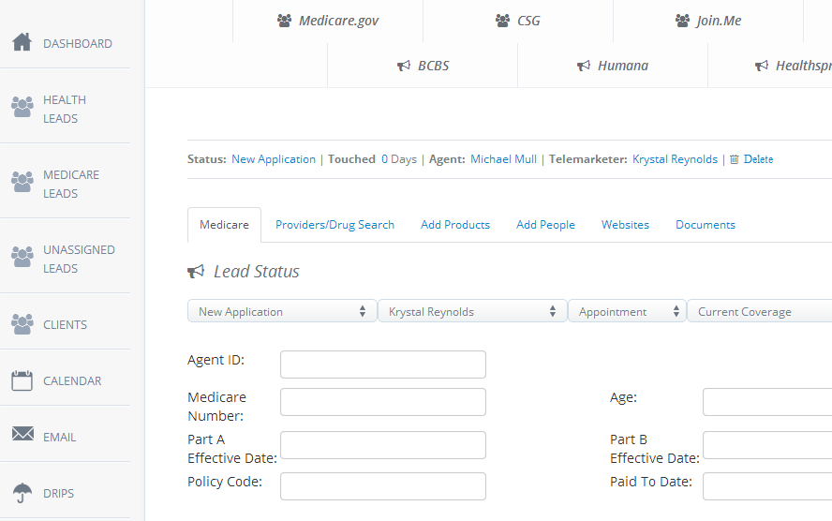
CSG Quoting Tool
Open lead in CRM

Slide 33
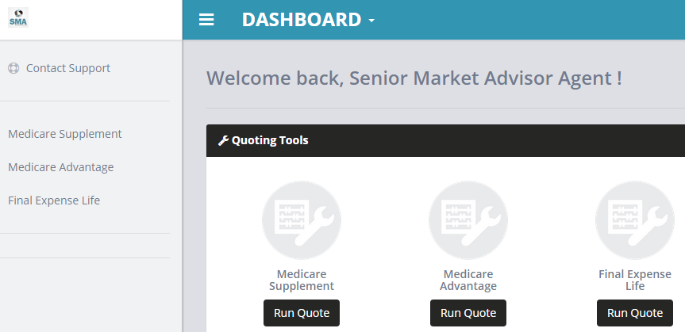
CSG Quoting Tool
Choose “Run Quote“ for Medicare Advantage

Slide 34
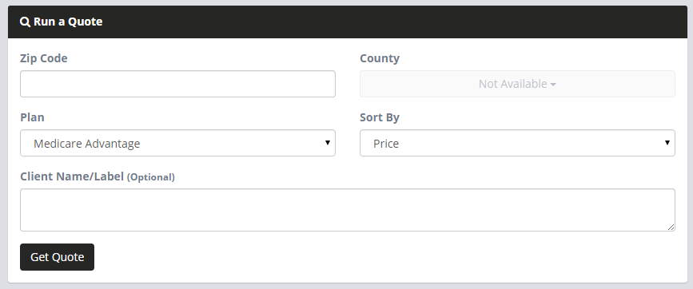
CSG Quoting Tool
Fill out all fields
Click “Get Quote!” link

Slide 35
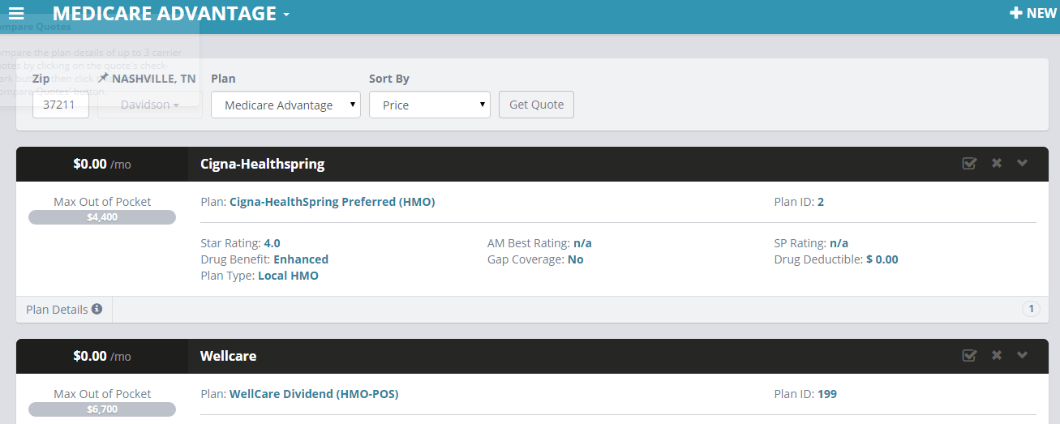
CSG Quoting Tool
Choose the beneficiary’s current plan or the plan that you are presenting.
Click “Plan Details”

Slide 36
CSG Quoting Tool
Click “Fill the Gaps”

Slide 37
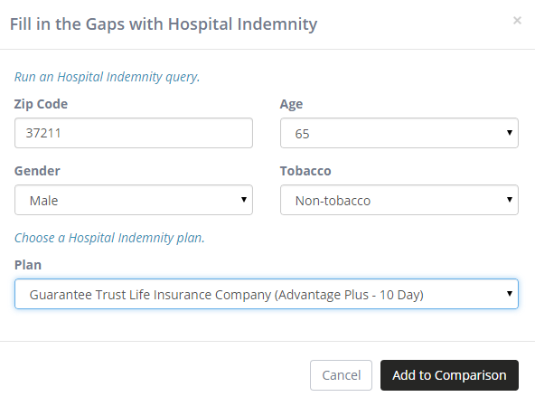
CSG Quoting Tool
Enter information, choose carrier, click “Add to Comparison”

Slide 38
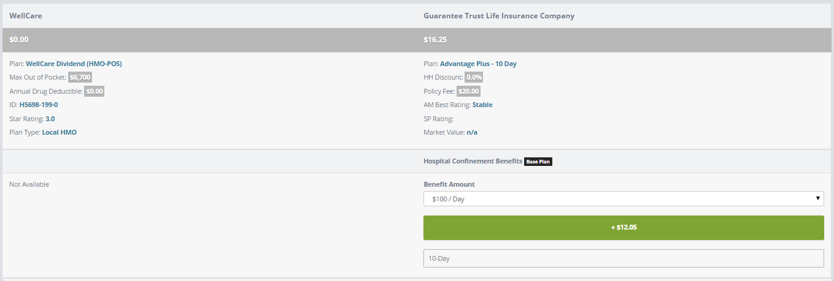
Review Benefits & Pricing
Scroll to quote rider elections

Slide 39
BONUS
Other Resources
Senior Market Advisors University

Slide 40
Agency Services
One of Our Uplines, Located in TN
Free to use anything on this site
Quoting tools for Life, LTC, Disability and Annuities
Applications
Will contract new companies when first line of business is written

Slide 41
www.agencyservices.com

