Slide 1
COURSE
Final Expense Product Training
Senior Market Advisors University

Slide 2
Training Overview
In this module, you will learn
Why final expense coverage is important
Ways to present final expense
The final expense Needs Analysis process
How to quote final expense
What products we offer

Slide 3
Why Sell Final Expense
Target Market: Existing Clients
Company Model: “Serving the Underserved”
Earn Extra Income
In 2012, 30 companies reported a total of $433+ million in new final expense sales
Nearly 700,000 policies issued for an average premium of $649
Average commission of $350 per sale
Simple-Issue on final expense = quick approval + fast pay
Retention: Stay in front of your clients
Beat the Competition: The final expense target market is the Baby Boomer generation

Slide 4
Advantages You Have
Existing Book of Business
Client Retention
Staying In Touch
Trust/Rapport
Referrals

Slide 5
Making the Difference
An Example
Current Policy
Variable UL
$150,000 Cash Value
$250,000 Face Amount
$3,400 Premium/Year
12% Projected Interest Rate
Customer
75-Year-Old Female
Preferred Health Status
Moderate Income

Slide 6
Agent Proposal
Guaranteed UL
$0 Cash Value
$500,000 Face Amount
$2,134 Premium/Year
3.1% Guaranteed Interest Rate
Policy Review Revealed
Set to Expire on 77th Birthday
Leaving No Life Insurance
Leaving $0 Cash Value

Slide 7
Solution
1035 Exchange
No Tax Consequences
Rolled Cash Value Into New Policy
Doubled Face Amount of Issue
Lowered Premium by $1,266/Year
Gained Client for Life
Agent Commission $39,432

Slide 8
LESSON
How to Sell Final Expense Policies
Senior Market Advisors University

Slide 9
Final Expense Procedure
1
TMs Set Appointments for Existing Clients
Agents Perform Clients’ Needs Assessments
New Policy Quoted/Policy Review Performed

Slide 10
Sales Sequence
This is a PROCESS…follow it EVERY TIME!
Walk through CHA’s In-Home “Family Protection Benefit” Presentation
You may also choose to show the video at this link: https://www.youtube.com/watch?v=ZKHftmGWoEM&noredirect=1
Complete the Needs Assessment at lifehappens.org
Quote 3 options: “Good”, “Better” & “Best”
Explain the benefits of each plan quoted
The Close:
Attempt to write new policy, OR
Complete an Existing Policy Review, OR
Explain process and importance of a Life Insurance Team Review

Slide 11
In-Home Presentation
Family Protection Benefit
Walk client through the following Final Expense Coverage presentation*
Be sure to ask questions
Wait for answers
Listen, listen, listen
*The following nine slides are a PPT presentation you can show on your appointment.
The presentation ends with a “Questions?” slide.

Slide 12
LESSON
Family Protection Benefit
Senior Market Advisors University

Slide 13
Why Most People Request Final Expense Coverage
You don’t have a Family Protection or Final Expense Plan and you’re worried about leaving a large bill to your loved ones.
You have some Family Protection or a Final Expense Plan but could use more. Perhaps your coverage is outdated, not enough or the wrong type of coverage.
Maybe you have enough coverage for your Final Expenses but want to leave a small benefit for someone special like a child, grandchild or great grandchild.
Which of these three best applies to you?

Slide 14
What are Final Expenses?
Final Expenses are what an individual’s loved ones pay upon death to settle funeral cost and miscellaneous bills.
The average cost of a funeral in 2013 was between $5,000 and $9,000 according to the National Funeral Directors Association. These numbers do not include cemetery costs.
Once you include cemetery costs, such as the plot, the opening and closing of the vault, the headstone and any extras like flowers, obituary notices and transportation, such as limousines, the total cost can quickly boost between $10,000 and $14,000.

Slide 15
Regulated Policies Have Features Necessary for Secure Final Expense Protection
Affordable premiums through DISCOUNTS (such as using a local bank).
Premiums are GUARANTEED Never to Increase regardless of changes to your age or health.
Death Benefit is GUARANTEED Never to Decrease regardless of changes to your age or health.
Benefits are paid directly to your Beneficiary Income Tax Free.
Policy is GUARANTEED Never to be Cancelled because of changes to your age or health, and it is completely portable if you move.
These are all WHOLE LIFE policies that accumulate Cash Values that can be used for emergencies or other financial needs.
No Medical Exam or Doctors’ records necessary to qualify.
How many discounts do you qualify for?

Slide 16
Creating Debt Someone Else Has To Pay
There are only four ways to pay for this debt:
Do Nothing: You could pass this burden on to your spouse, children, or grandchildren. However, most families are living paycheck to paycheck. Adding $10,000 or more of expenses could wipe them out financially or, at the very least, put a huge burden on them.
Use Money That You’ve Saved All Your Life: If a major illness or nursing home should become involved, that could wipe out your savings in a blink of an eye.
Pre Pay at a Local Funeral Home: This option can be VERY COSTLY! If you don’t have the funds to pay the cost in full, you will have to make payments to the funeral home with the possibility of finance charges being added to the balance. If you happened to pass prior to the balance being paid in full, your loved ones will be responsible for the remaining balance all at once. Even worse, the funeral home knows that your loved ones will not be shopping for the best price because they will be making decisions under duress.

Slide 17
Creating Debt Someone Else Has To Pay
There are only four ways to pay for this debt:
4. Acquire a GUARANTEED Final Expense Plan: This is ultimately the BEST option available to you. You can make affordable monthly payments into a whole life program that provides a death benefit in the amount of protection you desire. When you pass, your loved ones will have NO PAYMENTS REMAINING even if you passed the day after approval. Your rates and benefits will always be GUARANTEED never to change!
Which would you choose?

Slide 18
Common Questions: Planning for Final Expenses
Q – Is there a downside to waiting on setting up a Final Expense Policy?
A – YES. The cost of coverage is based on your age and increases as you get older. You will never be as young as you are right now, so waiting will only increase your monthly premium. Also, qualifying for a policy is based on your health. There is no guarantee that your health will remain the same and you will be eligible for coverage at a later date. Based on this information, purchase as much coverage as you can comfortably afford today.
Q – What if I can not afford the full $10,000 to $14,000 of coverage that I need?
A – We only recommend that you purchase a policy that you can comfortably afford to pay on a monthly basis. Many people will set up a “STARTER” policy first. This will give you some protection now with the hope that you will be able to add more coverage when you can.
Q – Is this a Term Policy?
A – NO. We would never recommend or offer a term life insurance policy for final expenses. By guaranteed, we mean that the premiums and benefits will never change and will be there for the rest of your life.

Slide 19
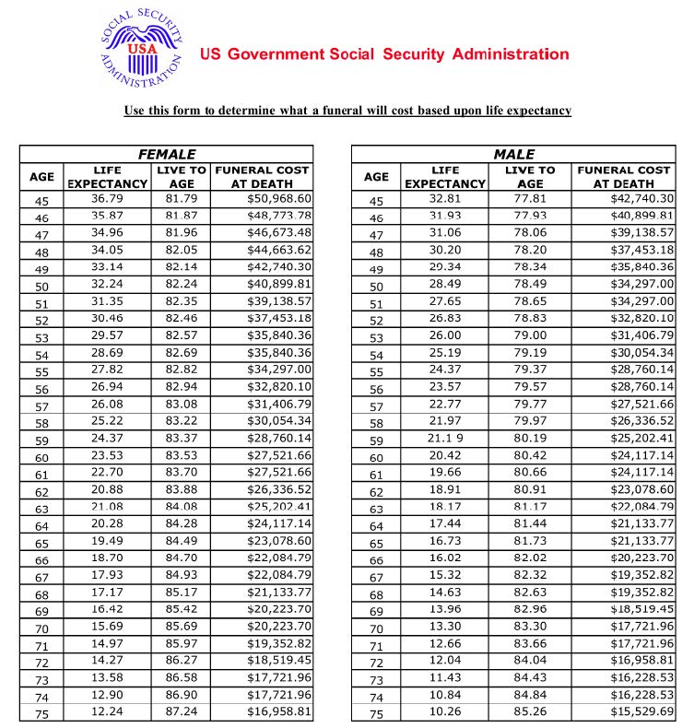
Determine Funeral Cost.
Use this form to determine what a funeral will cost based upon life expectancy.

Slide 20
LESSON
Needs Assessment
Senior Market Advisors University

Slide 21
Needs Assessment
Calculating Final Expense Coverage Amount
The client must participate fully in the process of filling out form at lifehappens.org
Don’t answer the questions for your client
Complete a paper Needs Assessment to leave with the client as he/she answers the questions online (this helps their memory later!)
Attach your contact information to the Needs Assessment

Slide 22
Needs
Assessment
lifehappens.org

Slide 23
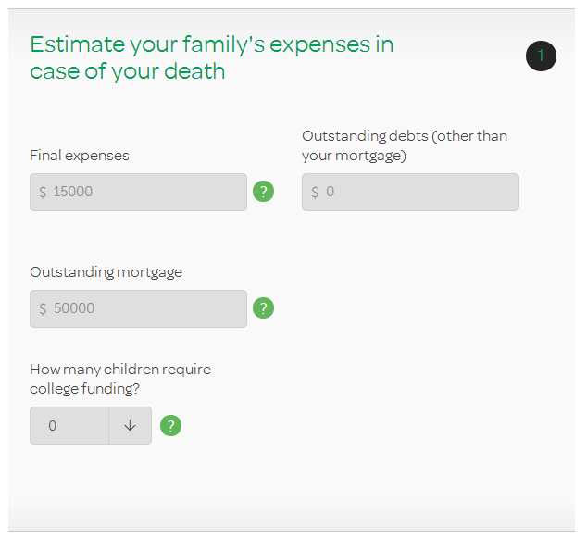
Needs
Assessment
lifehappens.org

Slide 24
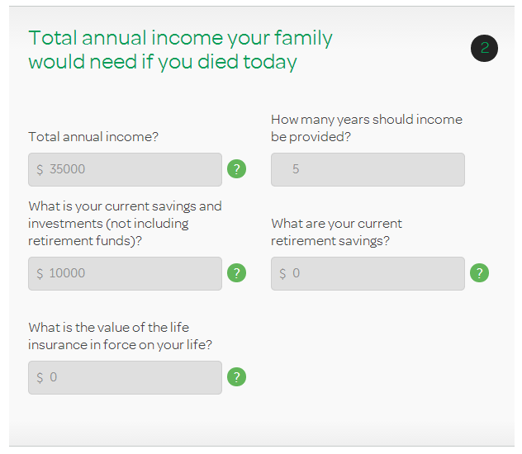
Needs
Assessment
lifehappens.org

Slide 25
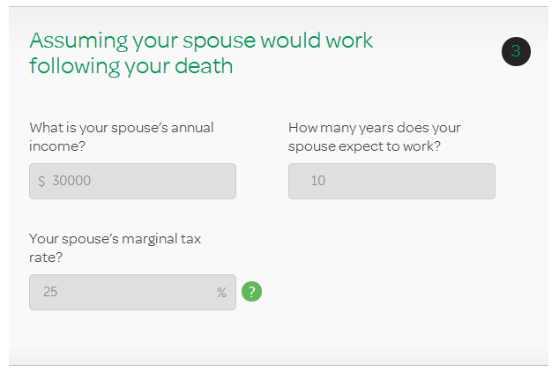
Needs
Assessment
lifehappens.org

Slide 26
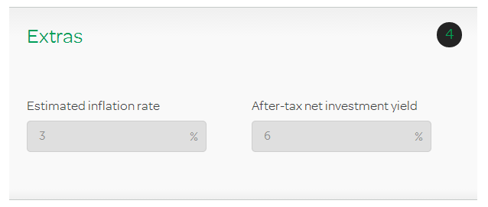
Needs
Assessment
lifehappens.org

Slide 27
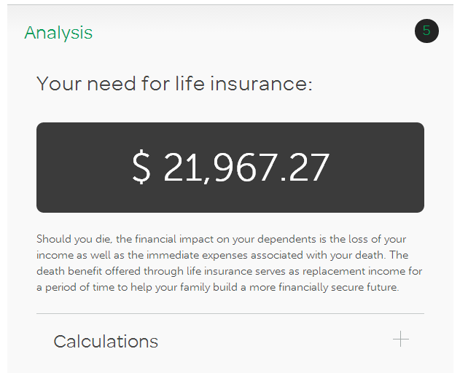
Needs
Assessment
lifehappens.org

Slide 28
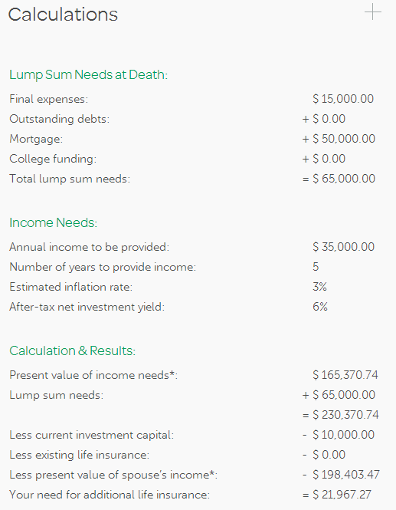
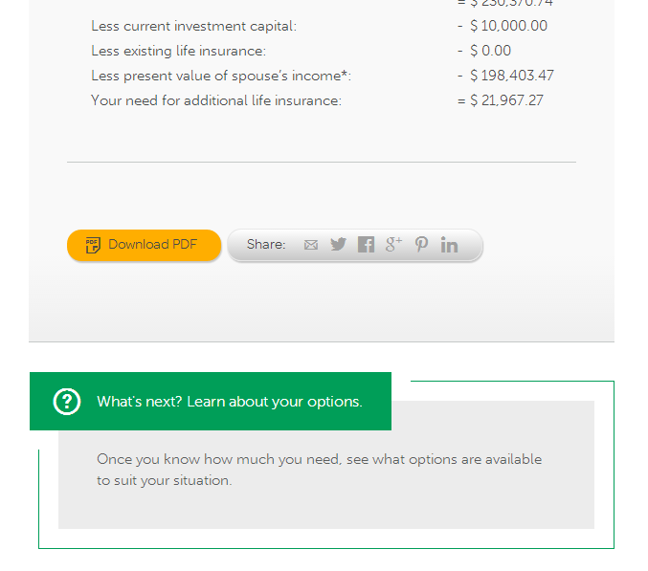

Slide 29
Quoting
Creating Options
Use the Funeral Cost Estimator from the Social Security Administration
Use the analysis from lifehappens.org
Create three quote options (good, better and best) for clients to choose from using the following three-slides

Slide 30
Quoting
“Good”
The difference between how much Final Expense coverage the client currently has and how much coverage the Social Security chart shows the client should have at his/her current age.
Example: Ms. Jones has $15,000 of existing life insurance.
$23,000 - $15,000 = $8,000
Ms. Jones would need $8,000 of additional insurance.

Slide 31
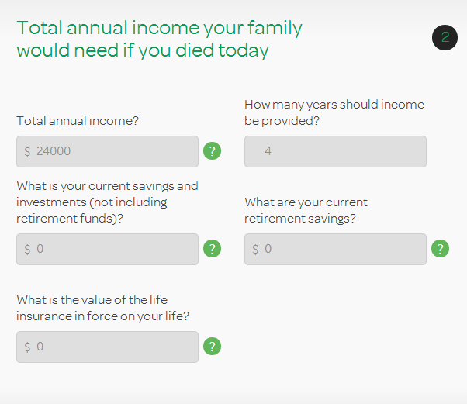
Quoting
“Better”
Use the Needs Assessment tool at lifehappens.org
Answer the question “How many years should income be provided?” with the number “4”
Don’t forget to fill out a paper Needs Assessment to leave behind with the client

Slide 32
Quoting
“Best”
Use the Needs Assessment tool at lifehappens.org
Answer the question “How many years should income be provided?” with the number “7”
Don’t forget to fill out a paper Needs Assessment to leave behind with the client

Slide 33
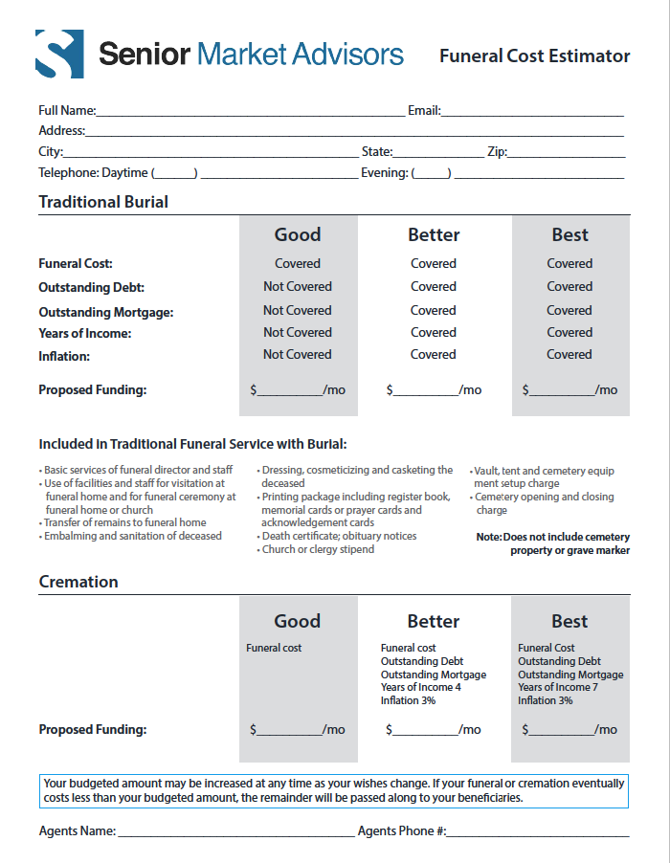
The Close
Reiterate emotional answers from client during Needs Assessment
Place finger on “Better” when presenting three options
Wait for response from client, do not be the first to speak

Slide 34
Scenarios
4 Possible Outcomes
Inadequate Coverage + Can Afford
= Write Policy
Adequate Coverage + Meet Stipulations = Policy Review
1
Inadequate Coverage + Cannot Afford
= Team Review
Unqualified
= Team Review

Slide 35
Life Insurance Team
Importance of “Team Review”
Grants peace of mind to customers, knowing that their best interests are in good hands
Affords agents time to review policy options that best suit the customers needs and wishes
Allows opportunity for third-party review from a fellow SMA team member
Ensures recommendation of the best policy to protect the needs of the customer

Slide 36
Existing Policy Review
What to Look For
Existing Universal Life, Whole Life or Term policies with
Adequate coverage
Face amounts of $5,000+
Policy owners aged 50+
Policies at least four years old
Premiums of $10,000+
Policies with cash surrender values of $1,000+

Slide 37
Existing Policy Review
Objective of Review
Owner understands exactly what they have & agent learns why
Uncover opportunities for improvement in premium payments and/or coverage
Interest rates are at historical lows
Underwriting has changed with medical advance
Life insurance policies may not perform to the standard originally illustrated
Review ownership and beneficiary structure
With longer life expectancy, policies may have become outdated
Premiums may be paid-up
Policies may be set to expire or terminate

Slide 38
Existing Policy Review
Benefits of Review
Lower Monthly Payment
“Refinance” to maintain/enhance current benefits & decrease payment
Insure That Coverage Outlives Policy Owner
Increased Benefits
Peace of Mind
Knowledge that the policy will be in place to meet its intended purpose(s)
Ownership and beneficiary designations will be correct

Slide 39
Existing Policy Review
Six Easy Steps
Collect a copy or snapshot of the most recent statement, if available
Complete “Fact Finder” & “Existing Coverage Analysis” forms
Help client fill out, sign & fax in “Authorization” form, if necessary
Conclude appointment & review/evaluate existing coverage with CHA team
Set follow-up appointment with client to discuss recommendations
Complete new application, 1035 exchange paperwork, state replacement forms, etc.

Slide 40
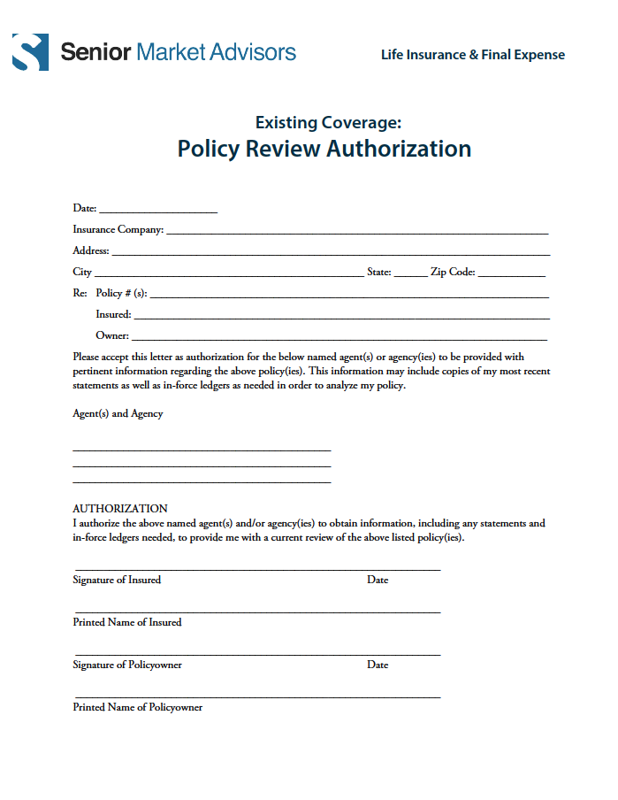
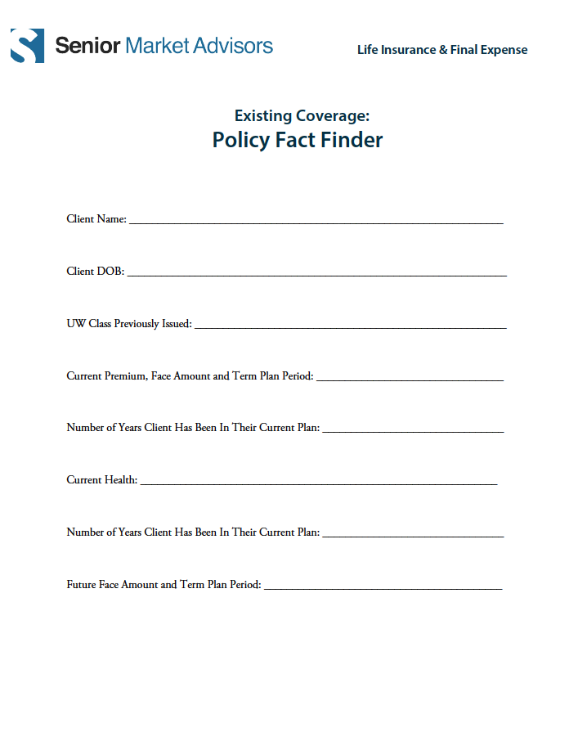
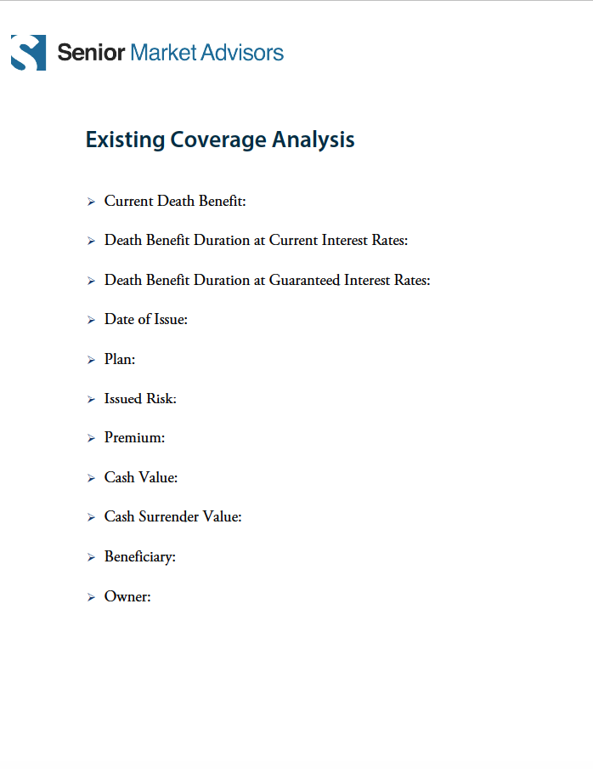
Existing Policy Review

Slide 41
LESSON
Quoting Final Expense
Senior Market Advisors University

Slide 42
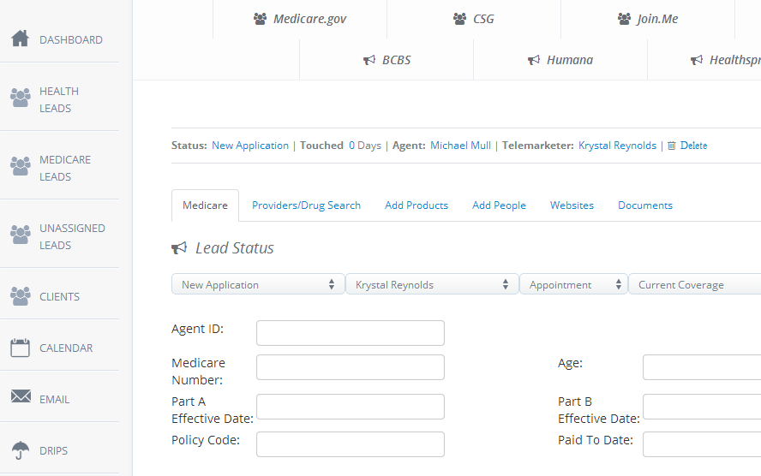
CSG Quoting Tool
Open lead view in CRM
Click “CSG”

Slide 43
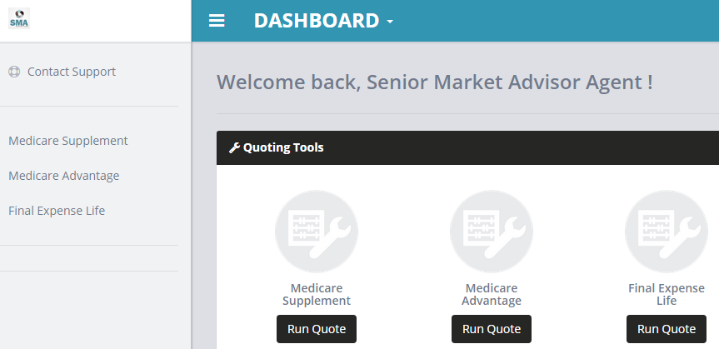
CSG Quoting Tool
Choose “Run Quote“ for Final Expense Life

Slide 44
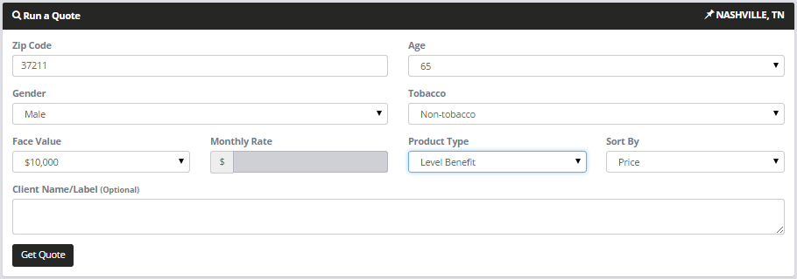
CSG Quoting Tool
Fill out all fields
Click “Get Quote”

Slide 45
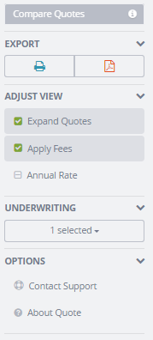
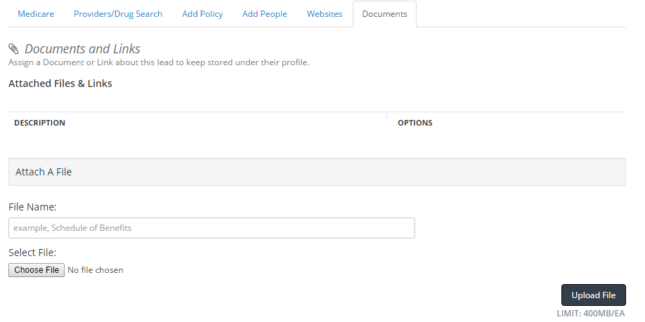
CSG Quoting Tool
Email, Print, PDF and Excel options to save to CRM
Filter Results
Underwriting Tool

Slide 46
Agency Services
One of Our Uplines
Free to use anything on this site
Quoting tools for Life, LTC, Disability and Annuities
Applications
Will contract new companies when first line of business is written

Slide 47
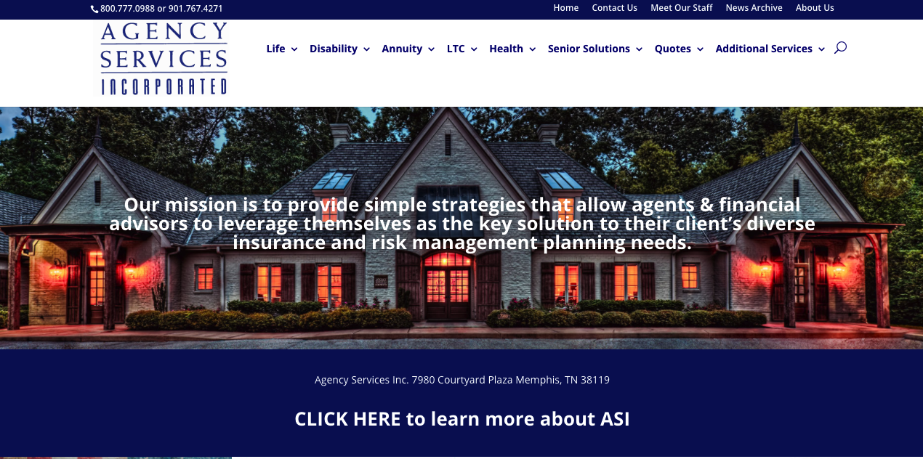
www.agencyservices.com

